Slide 1
Continuous Laser PIV design
Liu Hong

Slide 2
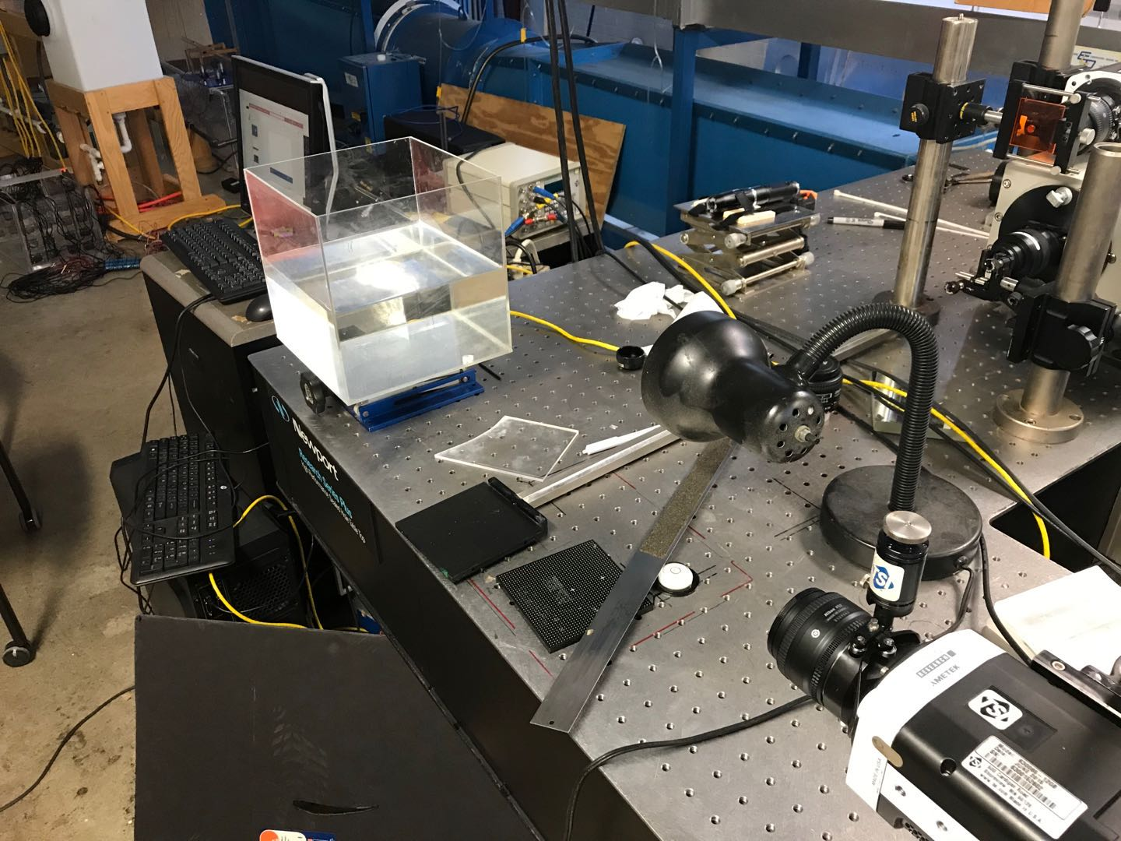
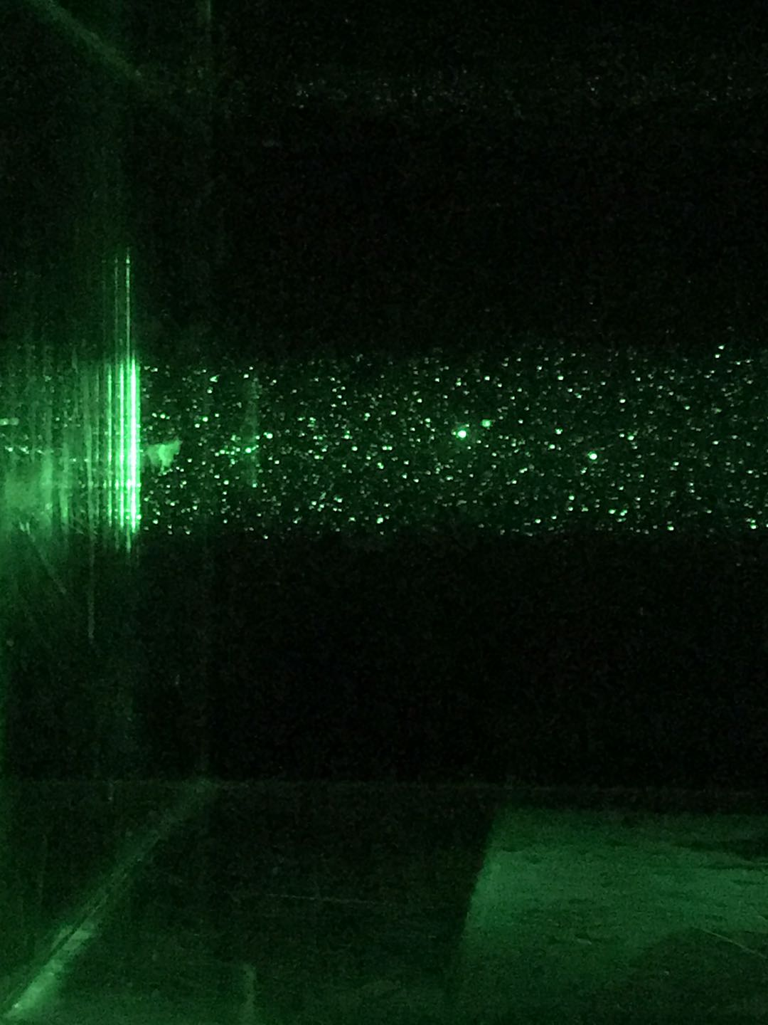
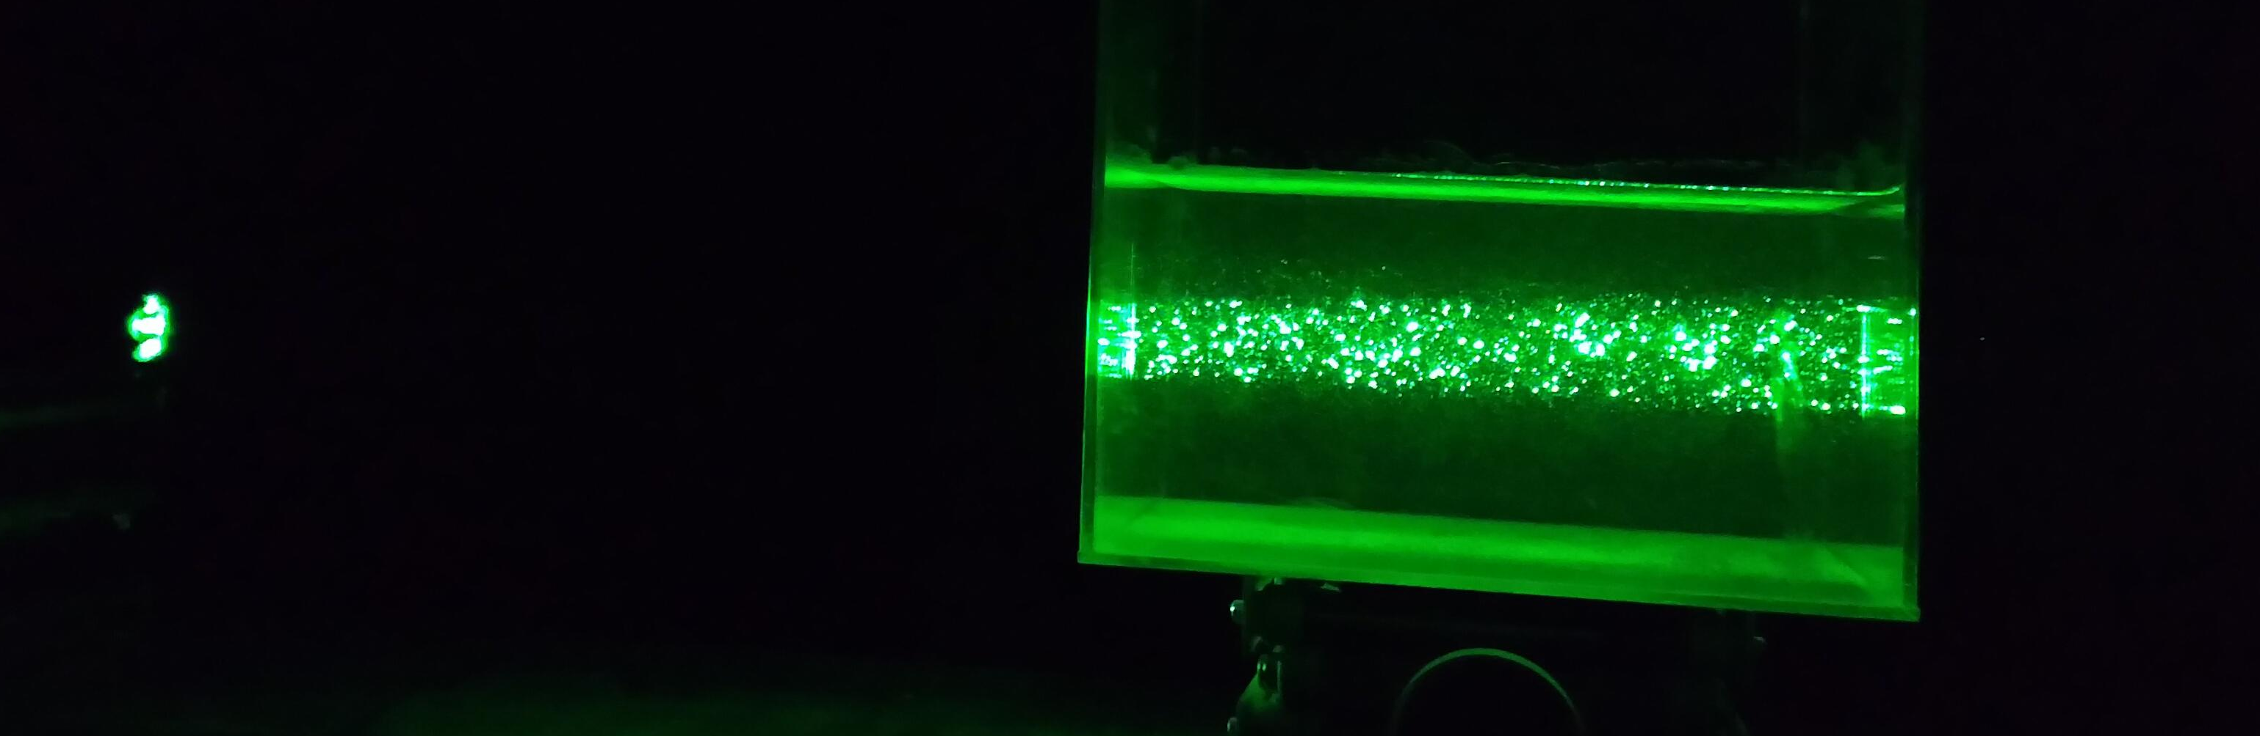
Laser point

Slide 3
Find appropriate delta t
This gif, please view in “slide show” mode

Slide 4
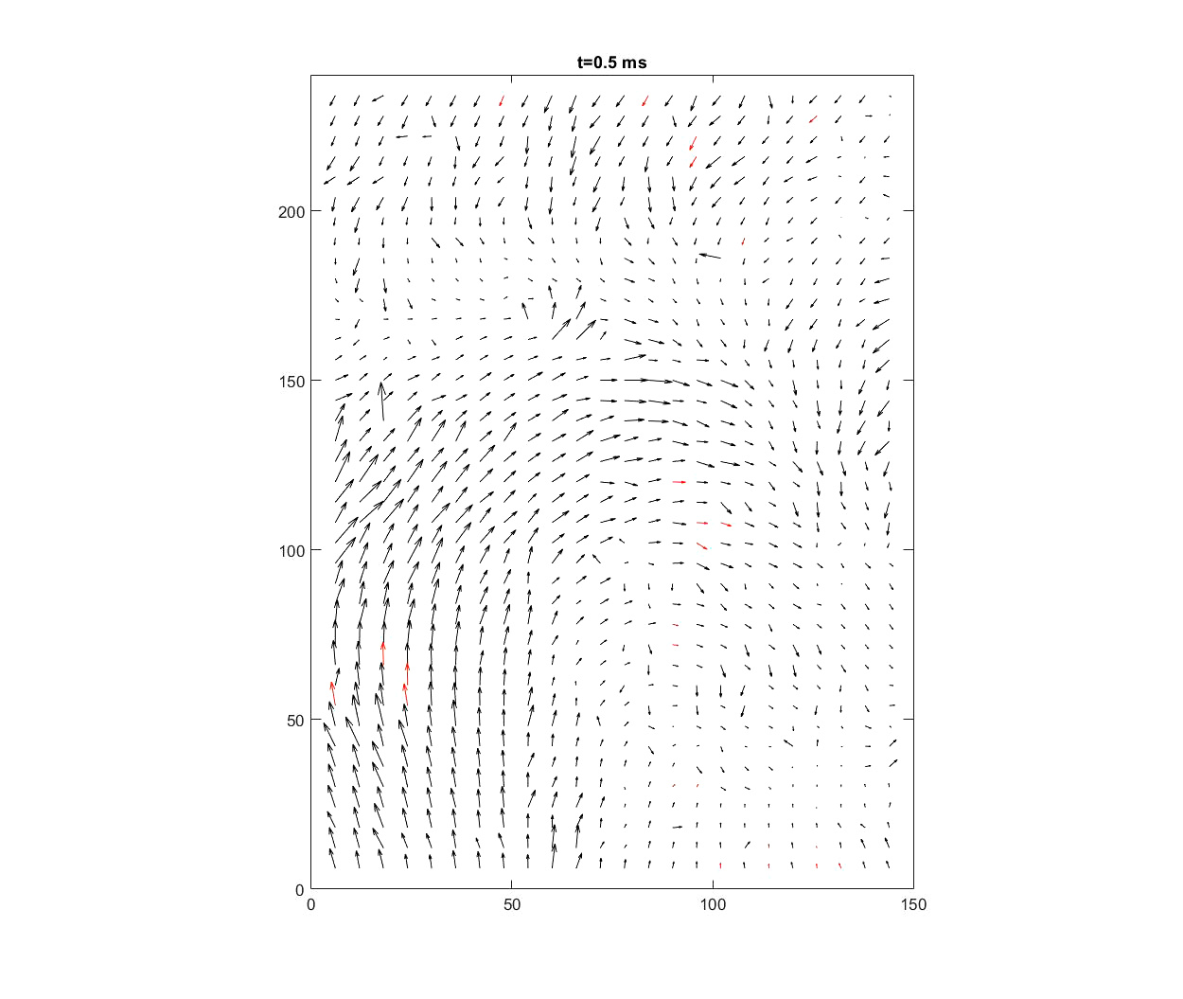
Resolution : 240x320
Crop: 240x150
Fps: 2000
Delta t: 300/2000 s
Number of frame: 25000 frames
Particle size: 55 um
Window size: 12
Overlap: 50%

